Slide 1
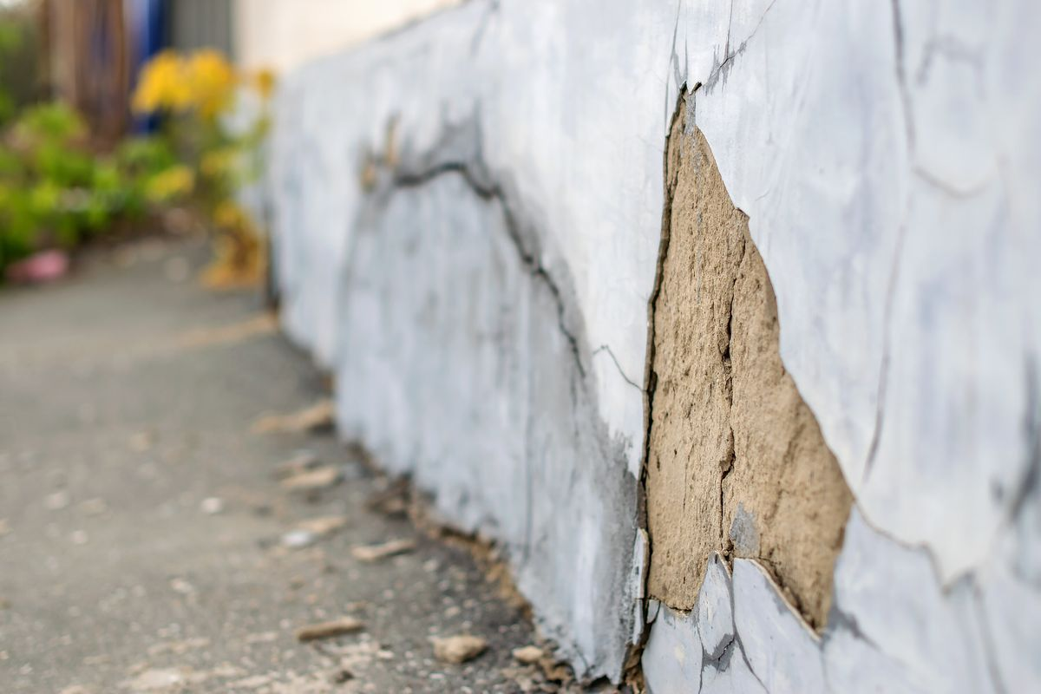
Infrastructure Surface Crack Detection
Team Members:
Botao Li, Inshira Seshie, Kaiqin Bian, Lawrence Bradley, Qinghao Zeng

Slide 2
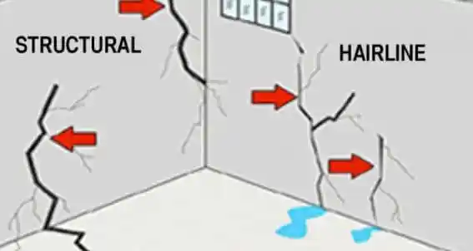
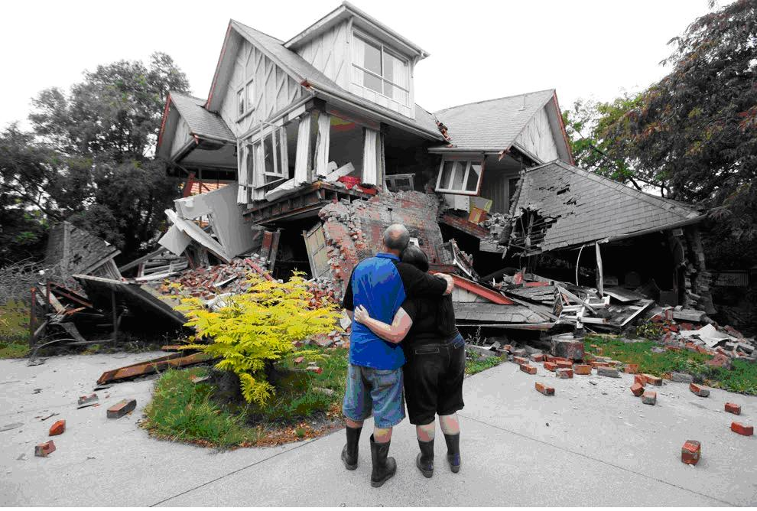
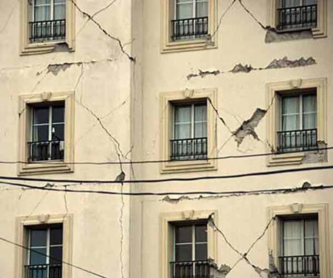
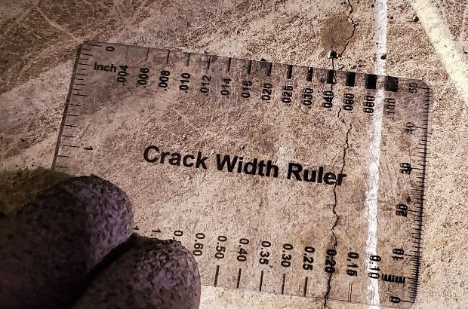
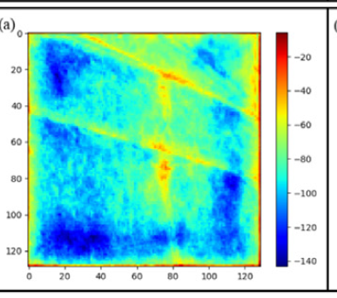
Introduction
Surface crack: Superficial line-shaped damages.
Risk of grave structural damage.
Manual inspection
Computer vision
（Mansuri 2021）

Slide 3


Problem Definition
Overall goals: Detect surface cracks + Evaluate their severity
Manual inspection
Time-consuming
Labor-intensive
Low quality
Inaccurate
CV & ML
An promising way to detect surface cracks efficiently.

Slide 4
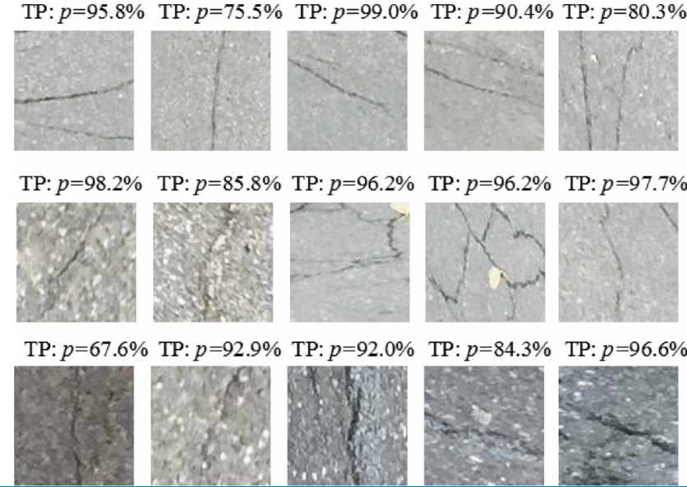
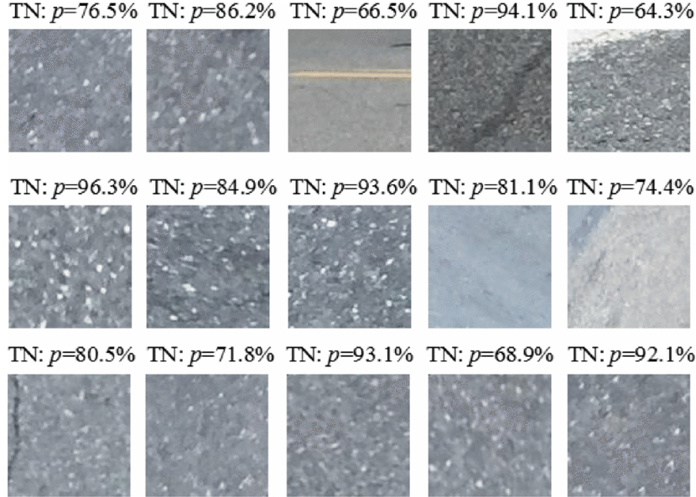
Data: Concrete Crack Images for Classification
Source: Website by
Detection of crack
Detection of non-crack

Slide 5
Methods
Supervised learning
Unsupervised learning
Task:
Overview:
Test Data:
Output:
Task:
Overview:
Clustering methods:
Clustering Evaluation:

Slide 6
Potential Results and Discussion
Overall Goal: Determine the effectiveness of the classifier and clustering model in the scope of the real world
Classifier
Able to accurately identify defects to help workers locate cracks within buildings
Clustering Model
Able to accurately report to supervisors the severity of the crack discovered

Slide 7
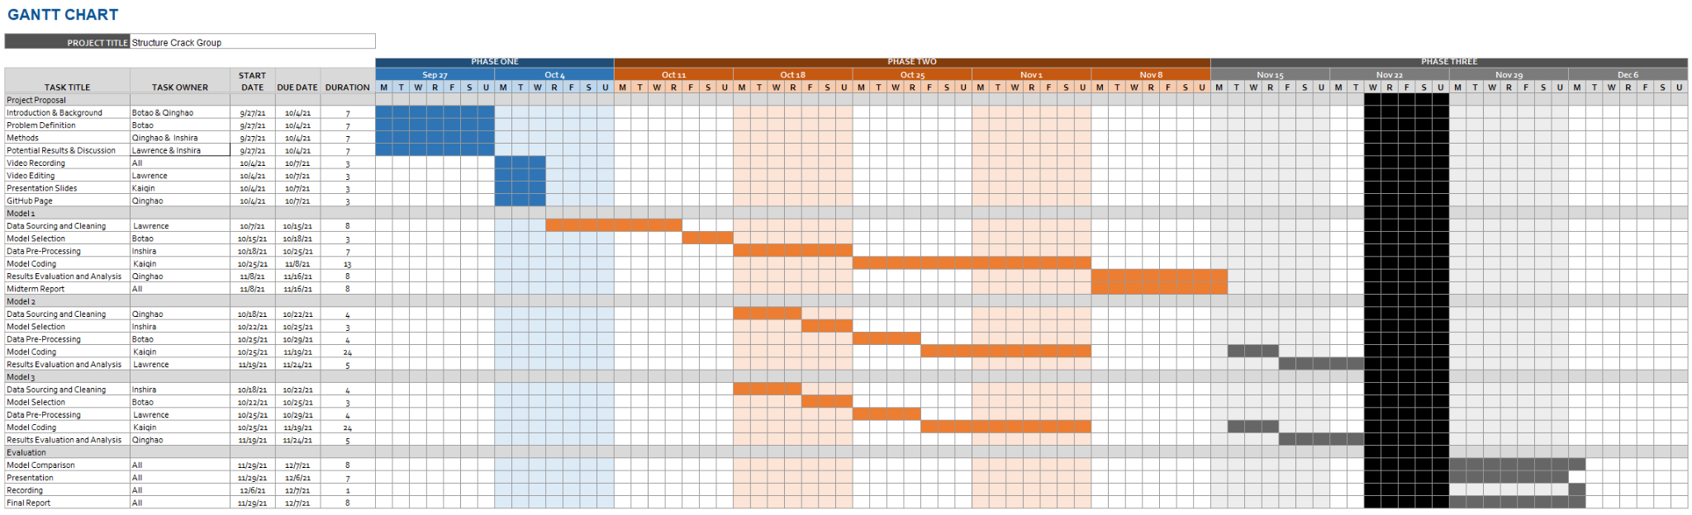
Timeline

Slide 8
References
Zou, Q., Zhang, Z., Li, Q., Qi, X., Wang, Q., & Wang, S. (2019). DeepCrack: Learning Hierarchical Convolutional Features for Crack Detection. IEEE Transactions on Image Processing, 28(3), 1498-1512. https://doi.org/10.1109/tip.2018.2878966
Munawar, H. S., Hammad, A. W. A., Haddad, A., Soares, C. A. P., & Waller, S. T. (2021). Image-Based Crack Detection Methods: A Review. Infrastructures, 6(8), 115. https://doi.org/10.3390/infrastructures6080115
Mansuri, L. E., & Patel, D. A. (2021). Artificial Intelligence-based automatic visual inspection system for Built Heritage. Smart and Sustainable Built Environment. https://doi.org/10.1108/sasbe-09-2020-0139
Mishra, M. (2021). Machine learning techniques for structural health monitoring of heritage buildings: A state-of-the-art review and case studies. Journal of Cultural Heritage, 47, 227–245. https://doi.org/10.1016/j.culher.2020.09.005
Lei Zhang , Fan Yang , Yimin Daniel Zhang, and Y. J. Z., Zhang, L., Yang, F., Zhang, Y. D., & Zhu, Y. J. (2016). Road Crack Detection Using Deep Convolutional Neural Network. In 2016 IEEE International Conference on Image Processing (ICIP). http://doi.org/10.1109/ICIP.2016.7533052

Slide 9
Thank you !

